Slide 1
Strategaeth Addysg a Hyfforddiant Seiliedig ar Efelychu Cymru Gyfan ar gyfer y Gweithlu Gofal Iechyd
Cyfarfod Cyffredinol Blynyddol AaGIC
Medi 2023

Slide 2
All Wales Simulation-Based Education and Training Strategy for the Healthcare Workforce
HEIW Annual General Meeting
September 2023

Slide 3

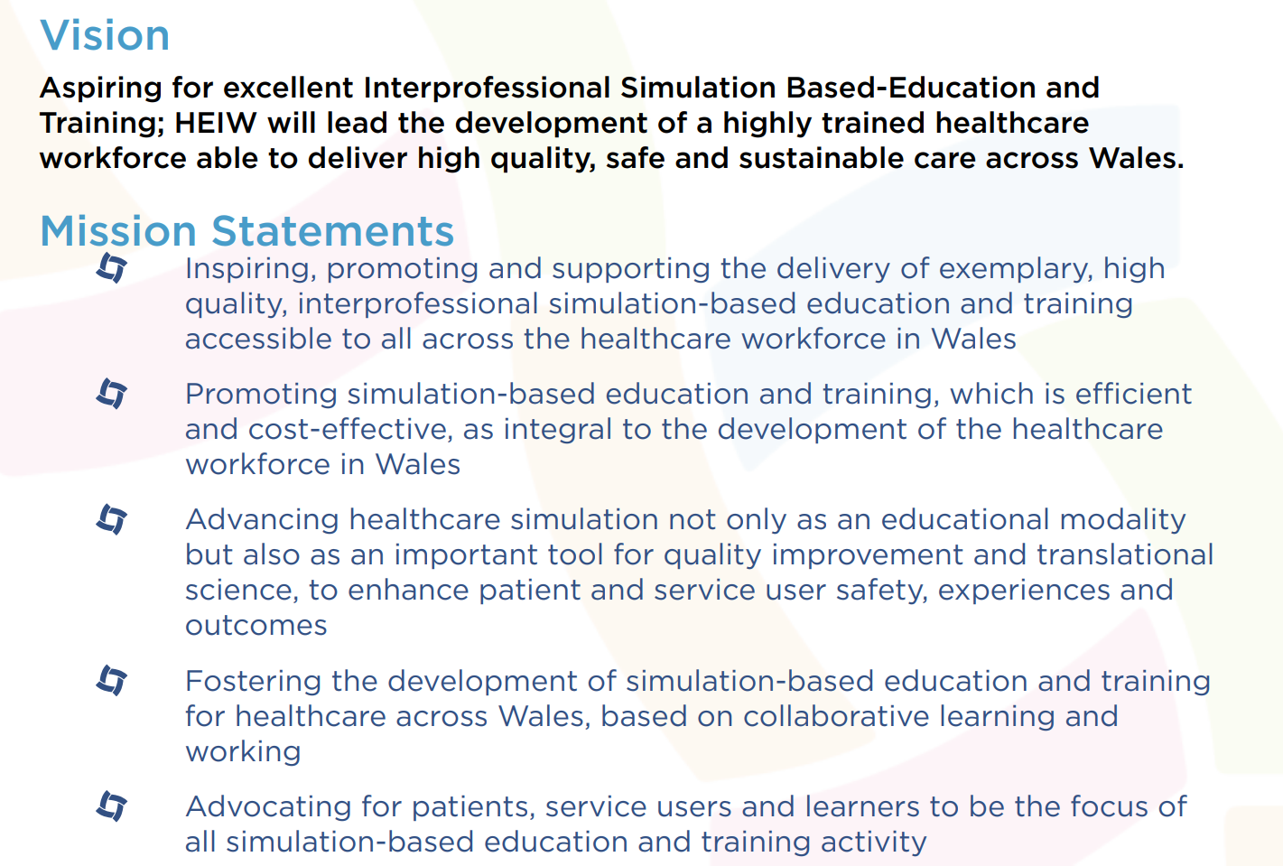

Slide 4

Amcan Strategol 2.1 / Strategic Objective 2.1
Arwain y gwaith o ddatblygu a rheoli seilwaith a strategaeth aml-broffesiynol ar gyfer Addysg Seiliedig ar Efelychiad
Lead the development and management of a multi-professional infrastructure and strategy for Simulation Based Education

Slide 5

547 munud
547mins
Rhaglen Ymgysylltu Helaeth
Extensive Engagement Programme
Patient and Service User Representatives
Learners
Simulation Experts
Simulation Community

Slide 6
Safonau /
Standards

Slide 7

Efelychu
Rhyngbroffesiynol
Interprofessional
Simulation

Slide 8

Hygyrchedd / Accessibility

Slide 9
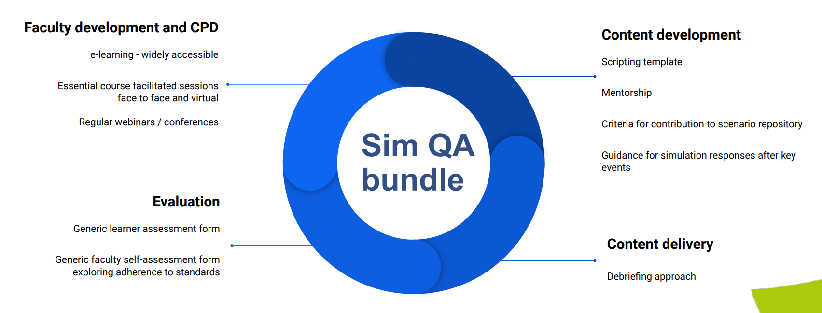
Sicrwydd Ansawdd / QA

Slide 10
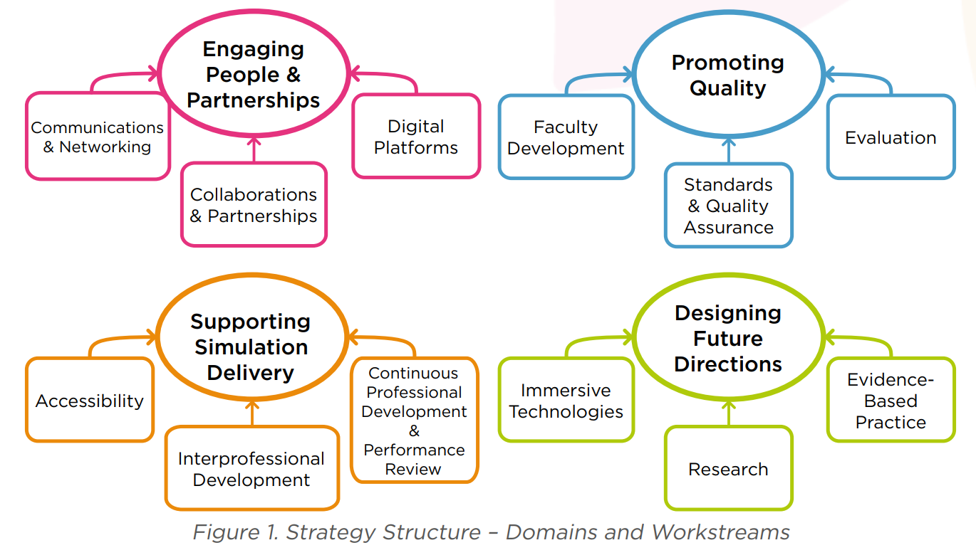

Slide 11

Cydweithio /
Collaborative Working
UK Four Nations
Simulation Societies
Simulation Experts
Other Experts

