Slide 1

Rhaglen Arweinyddiaeth Glinigol Uwch
Clinical
Leadership Programme

Slide 2
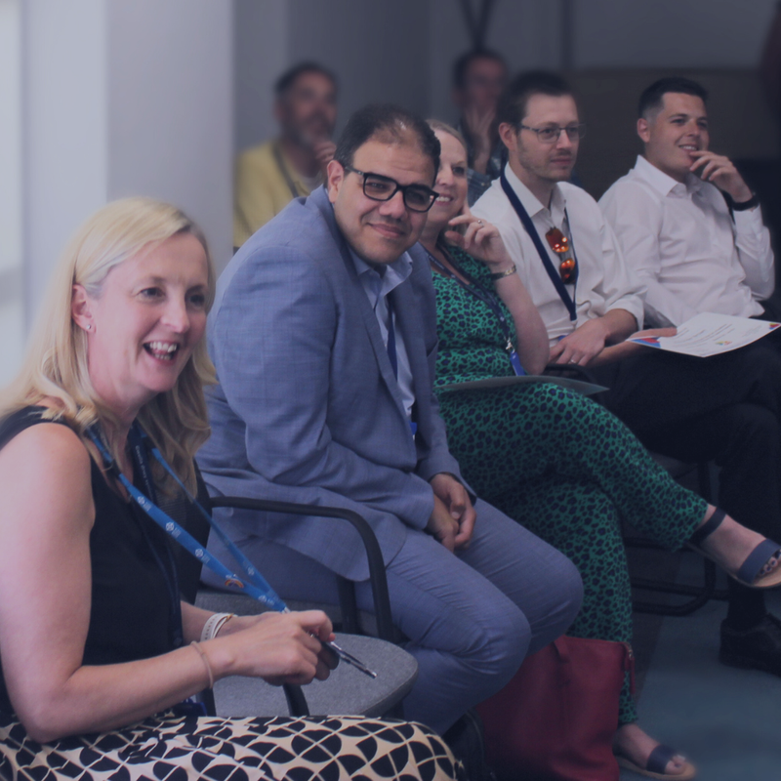

Multi-disciplinary intensive leadership development programme meeting needs of senior clinicians with ambition & capability to take up the most senior clinical roles in NHS Wales
Target:
  heads of service, clinical directors, assistant directors
  all clinical professions
Equitable access
  offered free of charge across NHS Wales
  self nomination, organisational endorsement
  2 day blocks to support those travelling
Delivery:
  10 months blended in person/online delivery
  residential component
Networking:
  executive mentoring
  mentorship practice

Slide 3
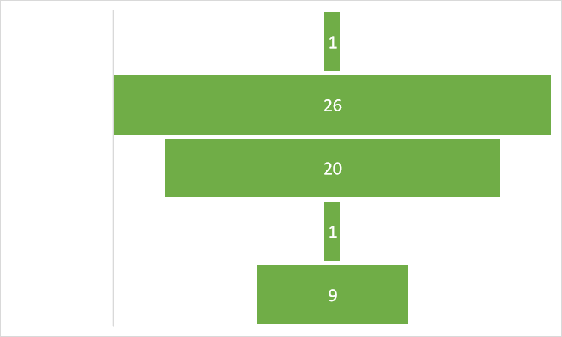
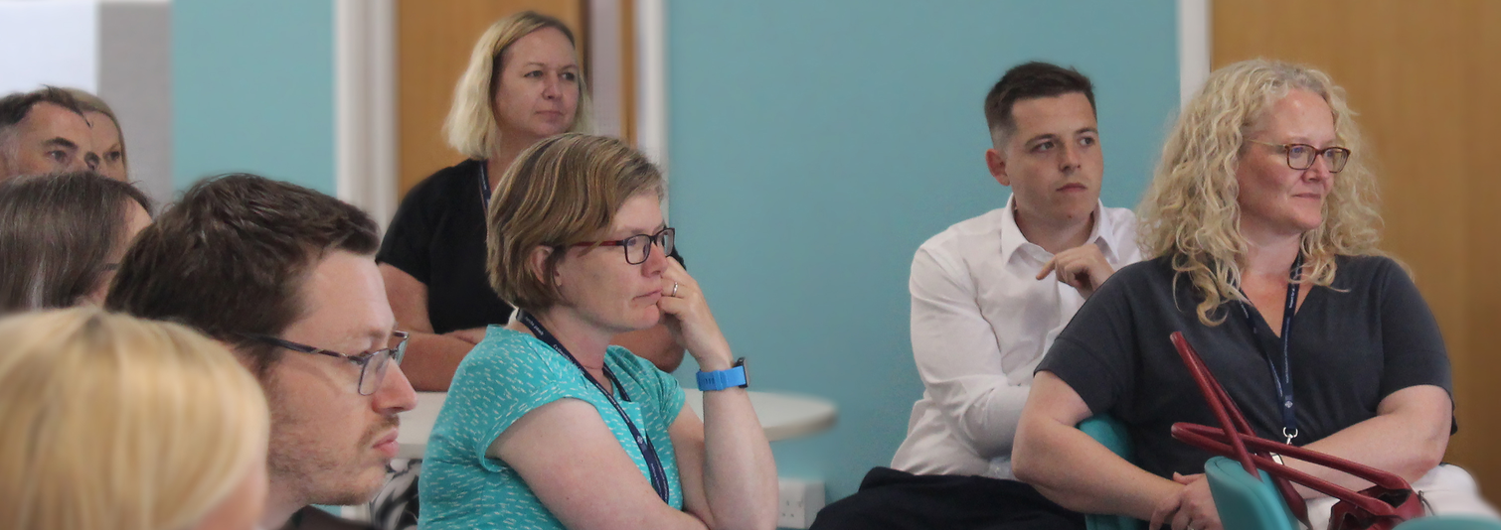
Psychology 2
Clinical Science 1
Pharmacist 6
Medical
25
Nurse/Midwife
11
Age
Range
Professional Mix
Cohorts﻿ 1 & 2 Demographics
AHP 11
35 Female
21 Males

Slide 4
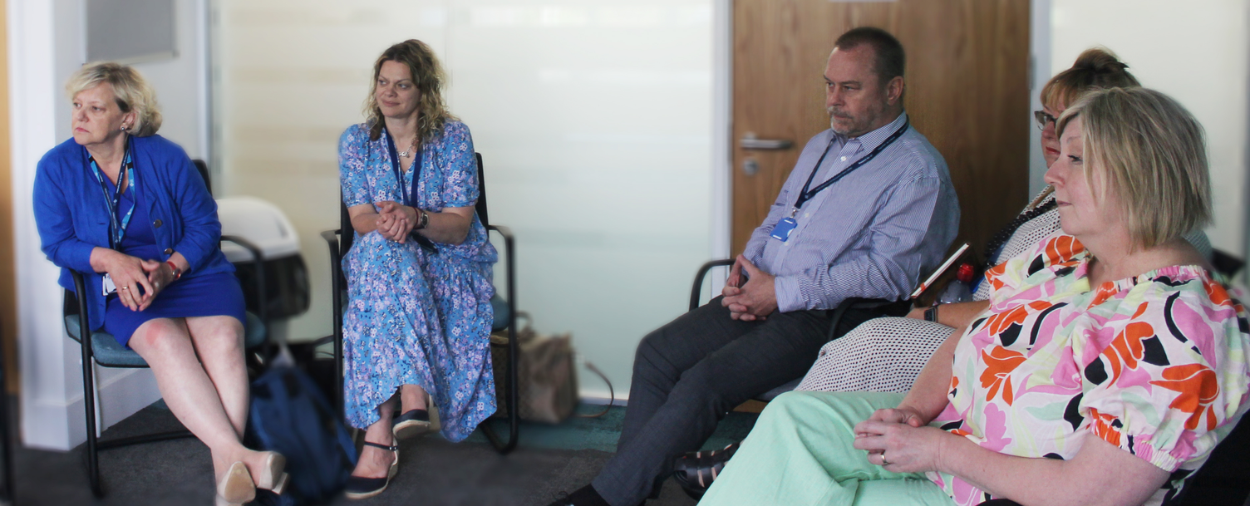
10 modules based around 3 themes:
  Leading Self
  Leading Teams
  Leading Systems
Underpinned by 3 threads running through all sessions:
  Compassionate Leadership
  Well-being (personal and team)
  Leadership or service change project delivery supported by quality improvement techniques
Mentorship by executive director
Mentorship practice - linked to participants on other HEIW leadership programmes
Action learning sets
Residential Learning Community
Leadership diagnostics/psychometrics
National networking opportunities
Cynnwys
&
Gwerth
Content
&
Value Added

Slide 5
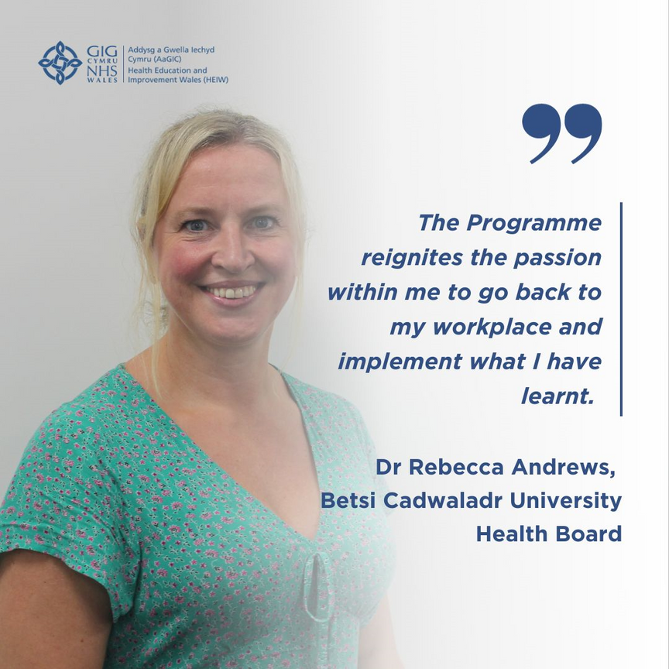
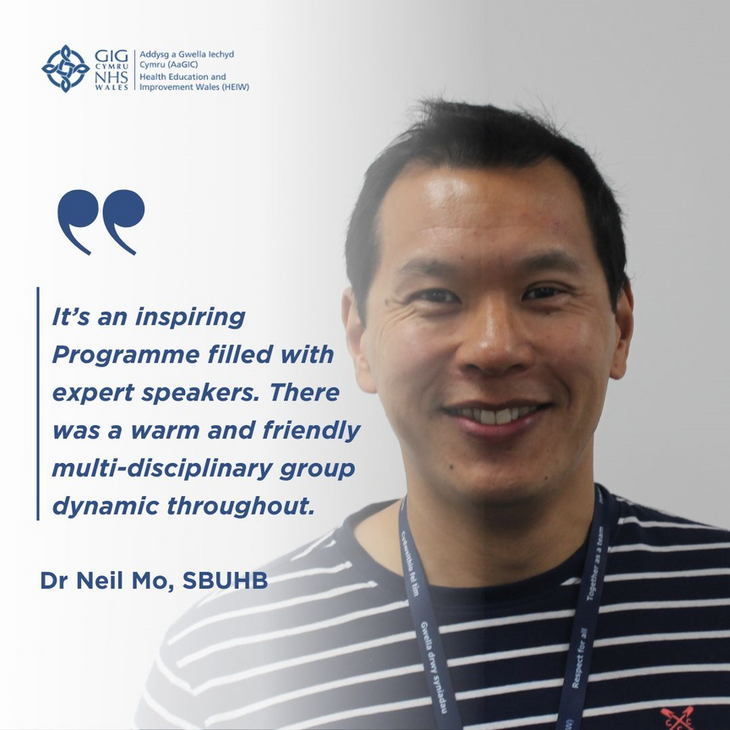

“Wow!
29 years in the NHS and this is by far the best course I have been on – thank you so much.
Great speakers, great resources and the best cohort of peers!
So much learning about myself, my leadership style and opportunity to reflect on where I am and where I would like to see my career take me.”
“The brilliant Advanced Clinical Leadership Programme offers a precious opportunity to learn, grow and flourish, building strong, supportive and abiding connections with other clinical leaders.
This programme offers a superb opportunity for clinical leads to shape the future of health and care in Wales."
Professor Michael West
Lisa Love-Gould,
Clinical Director for Therapies, Cwm Taf Morgannwg UHB

Slide 6
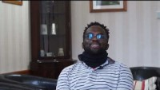

Slide 7
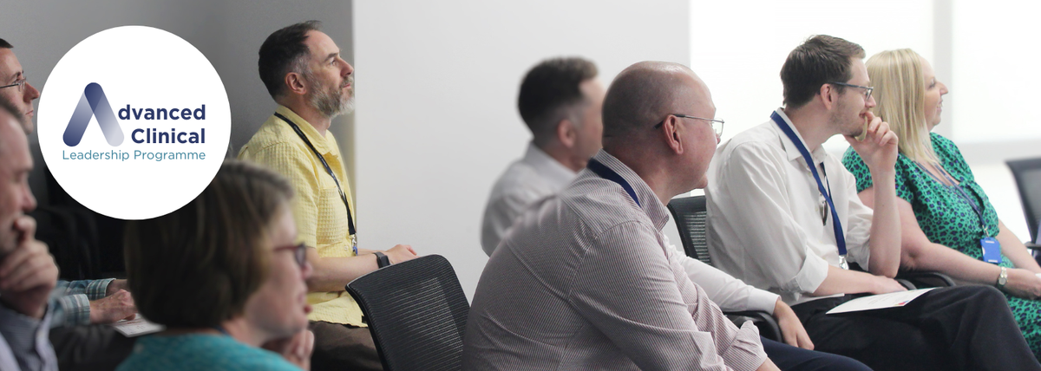
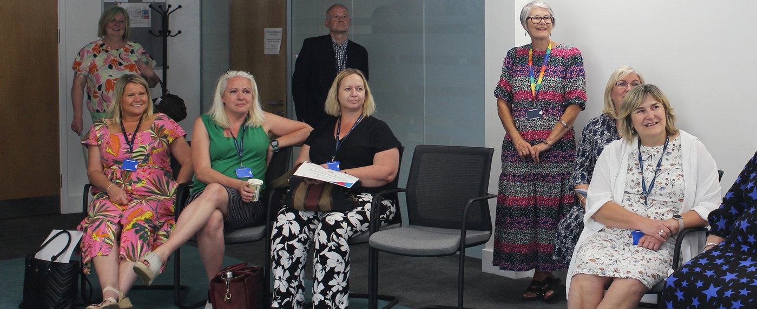
Camau nesaf
Next Steps
  Applications open for future cohorts mid July / 17th Sept 2023 - circa 200 applications expected
  Cohort 2 to complete programme in January 2024
  Deliver 2 further cohorts commencing Feb 2024, one based in North Wales
  Continue to refine and refresh programme content
  Bring together alumni from each cohort creating a vibrant national community of practice
  Measure programme impact
  Academic Accreditation

Slide 8
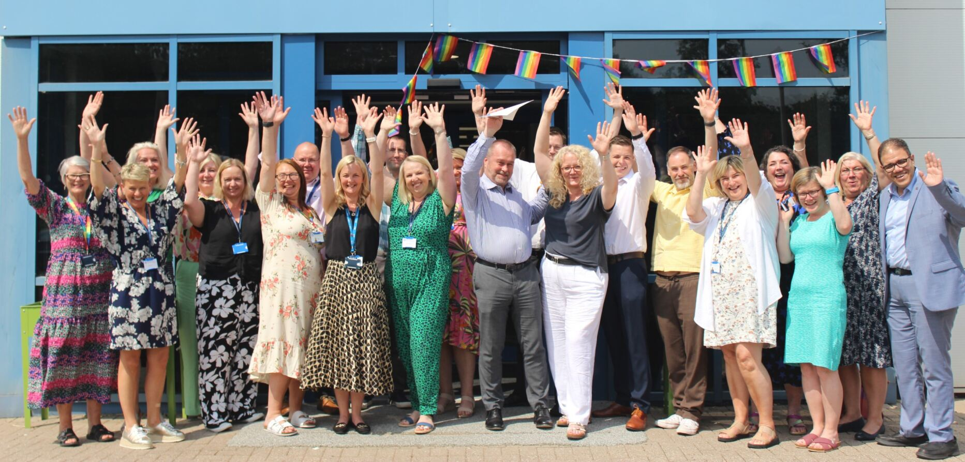
Rhaglen Arweinyddiaeth Glinigol Uwch Carfan 1
Advanced Clinical Leadership Programme Cohort 1

