Slide 1
System Rheoli Dysgu Y Ty Dysgu Learning Management System (LMS)

Slide 2
Amcan strategol 1.2.7: Gweithredu a gwerthuso System Rheoli Dysgu ‘Y Tŷ Dysgu’ yn llawn i wella ansawdd dysgu’r gweithlu a mynediad ato. Strategic objective 1.2.7: Fully implement and evaluate the ‘Y Ty Dysgu’ Learning Management System (LMS) to improve the quality of and access to workforce learning
Purpose of the objective:
Enhance HEIW’s reputation as a provider of quality education and training to the healthcare workforce in Wales
HEIW’s bi-lingual online learning and event management system with capability to support networking and communities of practice, Y Ty Dysgu will replace 3 legacy systems
Provide a standardised approach (quality and financial) for HEIW’s current provision of course management and delivery of online learning activities and KPI reporting
A vehicle for the operational delivery of HEIW’s CPD strategy and digital capability framework
Registration for up to 160K users during the lifetime of the contract

Slide 3
Map Gweithredu Implementation roadmap
Deploy MVP Dec 2022
Onboard HEIW teams & continue configuration from Q3 2022/23
Evaluate, improve and widen reach
2023/24+
Project teams configure, assure, test and deploy the core basic functionality to launch a minimum viable product (MVP) in December 2022
Iterative onboarding process with internal teams (discover, configure, train, test, deploy)
Configure more complex integrations and features, test and release in parallel
Develop evaluation plan
Identify phased improvements
Consider strategic opportunities for external partnership working

Slide 4
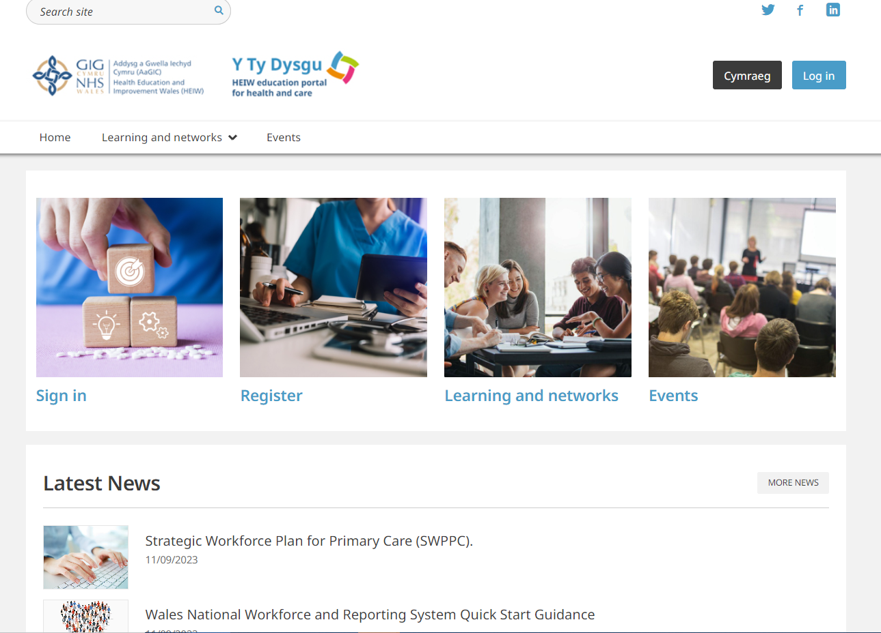
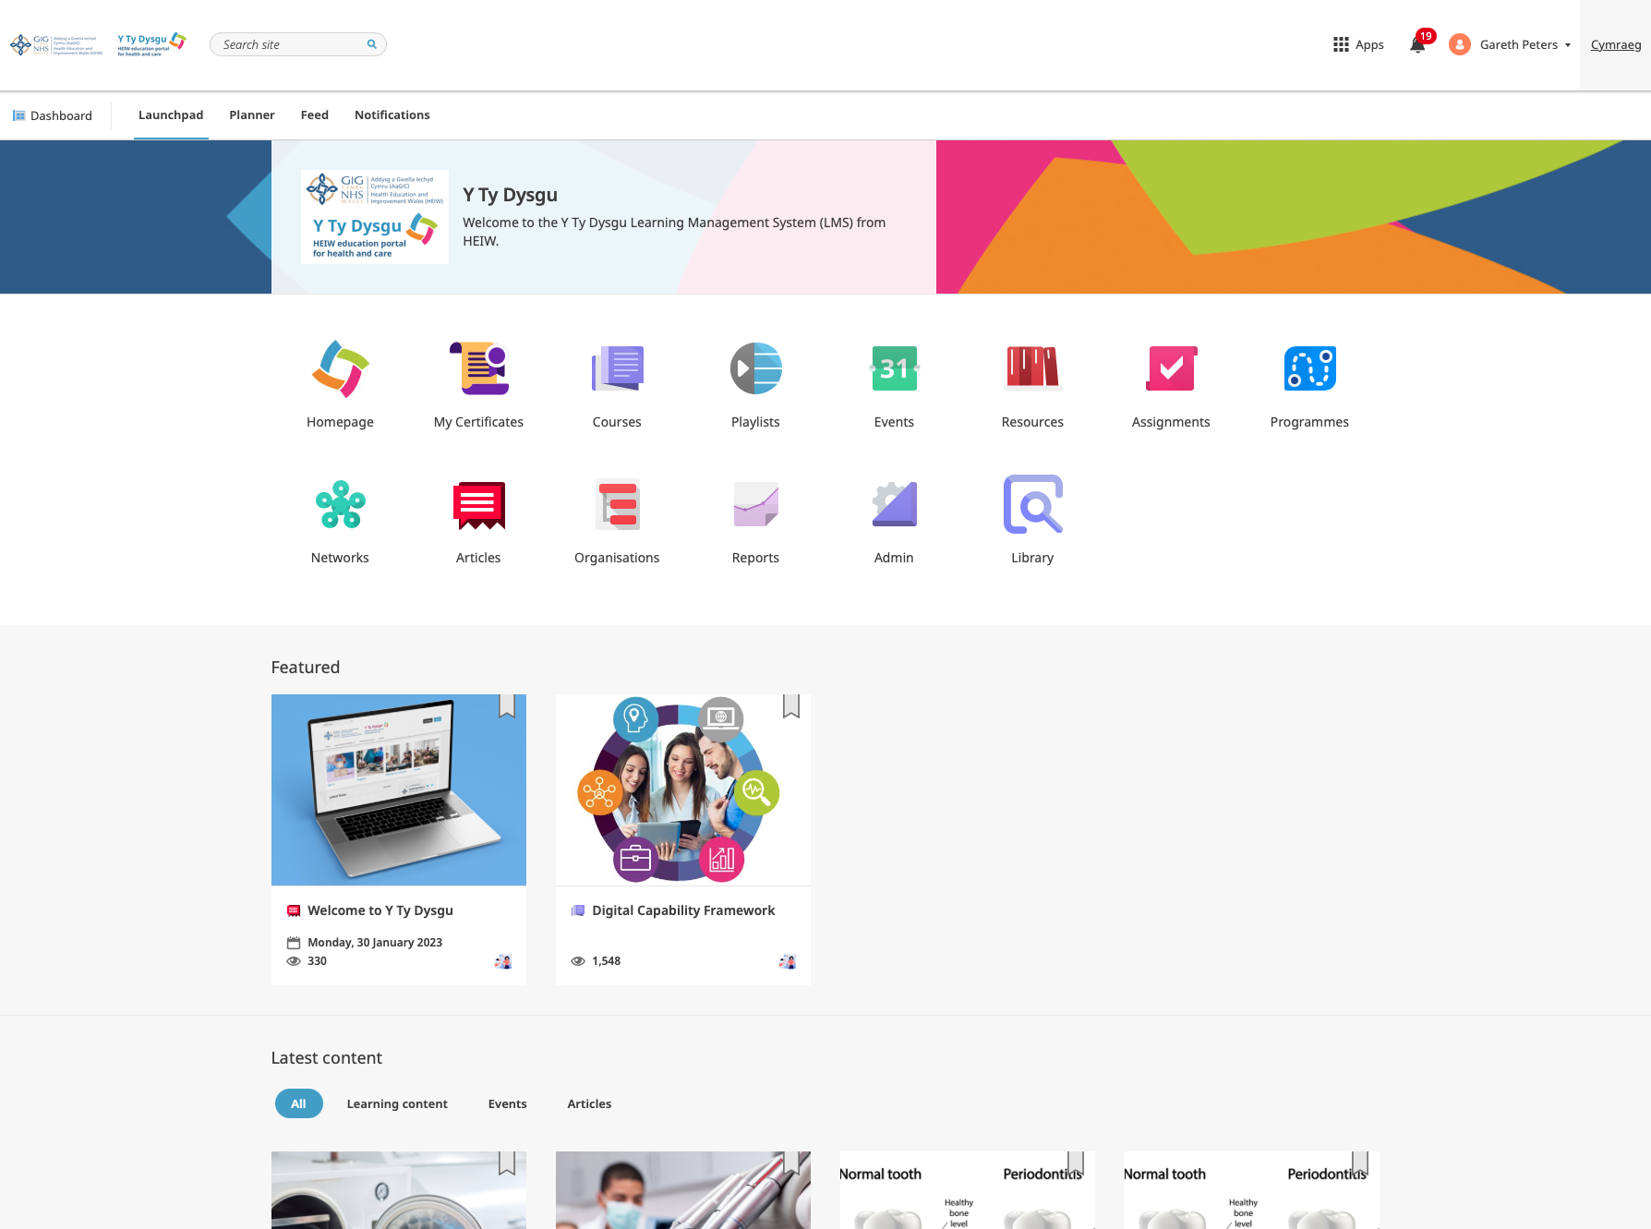
Publicly accessible landing page:
https://nhswalesytydysgu.heiw.wales/
Learning site, accessed via sign in. Homepage icon
allows user to return to public landing page:
https://ytydysgu.heiw.wales/

Slide 5


Ymsefydlu Y Ty Dysgu Y Ty Dysgu onboarding
Areas represented to date: Areas in progress:
Multi-professional More than just words/Mwn na geiriau
Simulation Pharmacy CPD
Genomics Pharmacy National Clinical Services Accreditation hub (NCSA)
Wales Health Student Forum Pharmacy Technicians
Digital Capability Framework Workforce Planning resources
CAMHS and Perinatal (Mental Health) MRCPsych
Inclusion
Exam preparation (Professional Support Unit)
Profession specific Primary and Community Care hub
Dental Health Inequalities (Allied Health Professionals)
Foundation Pharmacy Newborn & Infant Physical Examination Cymru (NIPEC)
Optometry GP Prospective Trainers
GP CPD
Immunisation
Clinical Photography (Work Based Learning)
4695 users ~30 modules and 100 events now live

Slide 6
Manteision Y Ty Dysgu Y Ty Dysgu benefits
Improved user interface (UI) and user experience (UX) - improving the learner experience
Improved Quality - QA principles of online learning co-produced with CPD Governance Group to ensure quality driven approach
Personalised learning experience - users directed to designated area upon log in and a ‘one stop shop’ approach - opportunity to develop learning ‘hubs’ to signpost courses, learning resources, events, networks and external resources and websites of interest
Improved value and reduced duplication - devolved target operating model to maximise license based cost model – up to 50K user licenses currently available and migration of ~500 learning modules in progress
Improved multi-disciplinary education - opportunity to increase multi-disciplinary learning offer for the health and care workforce
Increased reporting and insight - improved collection and monitoring of performance data
Dr Nik Sheen, Head of Optometry, HEIW: ‘Y Ty Dysgu as a platform is being well received by the profession and they have been complimentary about the modules!’
Kirstie Moons, Postgraduate Dental Dean, HEIW: ‘The Chief Dental Officer commented on how easy it was to sign up.’ Further testament to this is the ~2100 dental professional registrations on the system following launch in August.
Early benefit seen through the move to one system, enabling consistency of approach and providing enhanced quality,
functionality and reporting capability for a wider audience.

