Slide 1

Cyfarfod Cyffredinol Blynyddol
AaGIC
HEIW Annual General Meeting

Slide 2
Cyflwyniad y Cadeirydd
a Chroeso
Chair’s Introduction
and Welcome
Dr CDV Jones

Slide 3
Fideo Uchafbwyntiau
22/23
Highlights of 22/23
video

Slide 4
Diolch i’n partneriaid
Thank you to our partners
Social Care Wales
NHS
HEIs and other education providers
Professional Bodies
Key partners
UK Partners
Regulators
Staff organisations
Welsh Government
Part of NHS family
System role - involved in Welsh Partnership Forum, National Programmes, Peer Groups
Social Care Wales
Strategic, commissioning and contractual relationships with education providers
Targeted engagement and consultations
Political Briefings
Stakeholder Bulletin
Stakeholder Reference Group

Slide 5
Adroddiad y Prif Weithredwr
Chief Executive’s Report
Alexandra Howells

Slide 6
Am AaGIC About HEIW
Education & Training
Vision
“to develop a workforce that improves care and population health”
Culture and Leadership Development
Workforce Strategy, Planning & Insights
Purpose
“as part of the NHS, to work with partners to plan, develop, educate and train the current and future workforce”
Added Value
“is to address strategic and specialist workforce opportunities and risks that affect workforce demand and supply, through our statutory functions”
Workforce Transformation
Careers and Widening Access

Slide 7
Adolygiad o uchafbwyntiau 22/23
Review of 22/23- Highlights
Supported workforce solutions for the national programmes, networks and professional frameworks
Launched the Strategic Mental Health Workforce Plan
Refreshed and relaunched TrainWorkLive attraction campaign
Expanded leadership development programmes, support and talent management
Finalised HEIW’s Digital and Data Strategy
Implemented Y Ty Dysgu Learning Management System
Produced a Digital Capability Framework
Implemented new contracts for undergraduate health professional education
Established new multi professional primary care education framework
Developed our clinical placement capacity including in care homes
Launched a Simulation Strategy
Show case presentations will follow

Slide 8
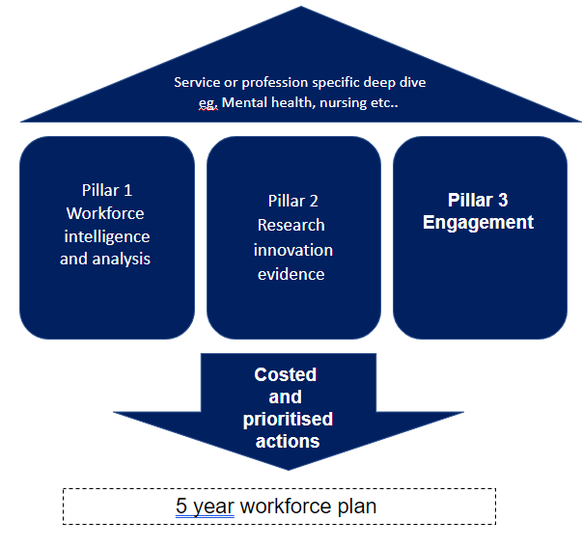
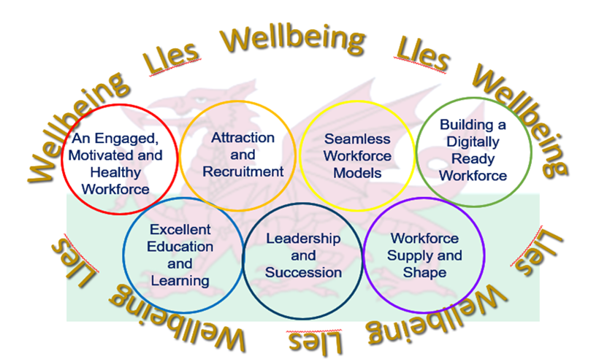
Datblygu Cynlluniau Gweithlu Strategol
Developing Strategic Workforce Plans
Mental health, Pharmacy, Primary Care, Perinatal, Nursing, Dental, Diagnostics, Genomics
Ten Year Workforce Strategy
Methodology

Slide 9
Uchafbwyntiau Comisiynu
Commissioning Highlights
Health Professional
Ninth consecutive year education and training budgets have increased
Many programmes delivering as planned – exception is nursing in line with trends across UK.
Fill rates dipped in 22/23 to 76%. – however in numbers terms this translated to a 6% reduction from the previous year (1995 to 1878) and is second highest number achieved.
HEIW leading on a raft of measures to increase applications to places in collaboration with partners.
Pharmacy
109 pharmacy trainees have now completed.
Overall pass rate for Wales is 88.4% above the GPhC average of 80%
65 of 100 trainees have stated an intention to get their first job in Wales.
Pre registration Pharmacy Technicians, new high of 83 trainees yr 1 of the new Level 4 programme
Medical
Positive trend in GP Training recruitment, c half of all GP practices in Wales now training
Programme for speciality training expanded by 92 posts August 2023
Foundation Training increase of 183 posts between August 2020 and 2023
Establishment of North Wales medical rotations with NW Deanery in NHSE
Enabling flexibility (flexible portfolio posts created, new approach to supporting less than full time working)
Dental
Local incentivised recruitment scheme launched to recruit to rural areas
Train Work Live campaign launched in March 2023 to improve overall recruitment to Wales
Dental Nurse Training Programme established to address workforce shortages

Slide 10
Ansawdd
Quality
Using National Student Surveys and National Trainee/Trainer Surveys to highlight areas for improvement with Higher Education Institutions and NHS organisations
Supported further investment in Professional Support Unit in response to increased demand and scope
Continued focus on quality management of Postgraduate Medical Education on behalf of the GMC through targeted visits and application of enhanced monitoring (6 sites during the year)
New contractual mechanism provides clearer escalation process for commissioned health professional programmes
Launched Advancing Equality in Education and Training (AEiET) Group
Continue to embed Quality Management process in Pharmacy and Dental Deaneries
Continued focus on development of QI skills
Duty of Quality will require HEIW to fundamentally review what quality means in the organisation and demonstrate compliance with the new standards

Slide 11
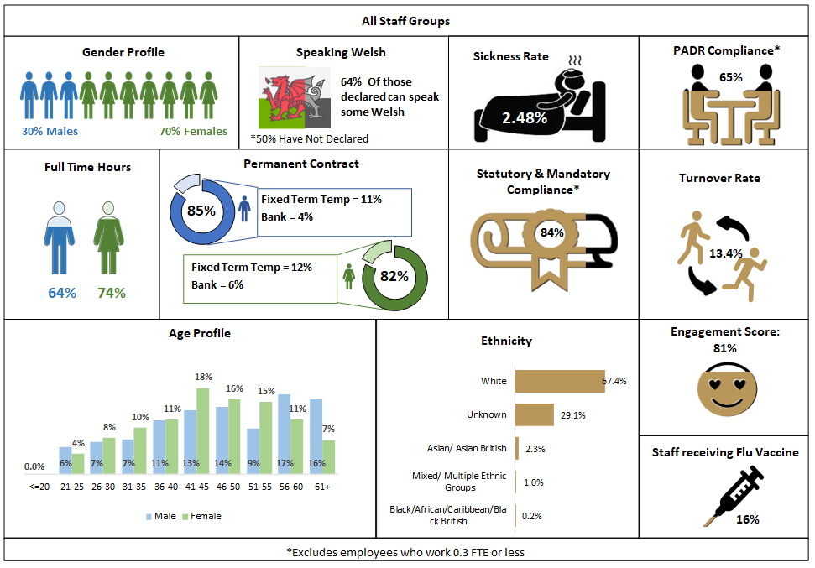
Perfformiad Mewnol AaGIC
HEIW Internal Performance

Slide 12
Datblygu ein Pobl
Developing our People
Launched of our Human Centric Management Development Programme
Delivered over 20 Insights Discovery Self Awareness and Team effectiveness Workshops and 150+ profiles across HEIW
Streamlined Access to our Learning and Development central resource to support both individual and team development needs
Established work-based learning opportunities including Institute of Leadership and Management , Chartered Management Institute, National Vocational Qualification and City and Guilds
Held three virtual and one in person staff conference
Delivered a range of Inclusion awareness workshops and webinars including Anti-Racism, Deaf Awareness and Autism Education

Slide 13
Materion a Risgiau yn ystod 22/23
Issues and Risks During 22/23
Quality of trainee and student experience.
Funding support for education and training v cost of living.
Publication of the National Workforce Implementation Plan.
Industrial relations issues at national level.
Data and intelligence to inform planning and measurement.
Applications for undergraduate programmes impacting on delivery and finance.

Slide 14
Trosolwg Cyllid /Finance Overview 2022-23 Cyfrifon Blynyddol /Annual Accounts
Glyn Jones
Cyfarwyddwr Cyllid Cynllunio a Pherfformiad /
Director of Finance, Planning & Performance

Slide 15

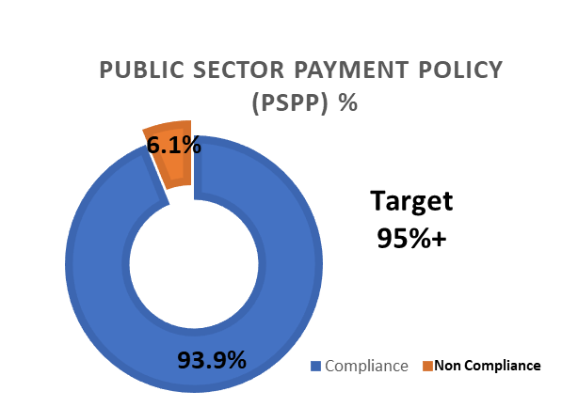
2022-23 Targedau v Cyflawniad
2022-23 Targets v Delivery
Revenue Performance
£1.141m (0.4%) underspend against a Revenue Resource Limit of £289.361m
√
Pay a minimum of 95% of all non NHS
creditors within 30 days of receipt of goods or a valid invoice.
Capital Performance
Breakeven against a Capital Resource Limit of £226,000
√
Ensure expenditure does not exceed the resource limit (funding) in the financial year.

Slide 16
Cymharydd Gwariant 2022-23 v 2021-22
Spend comparator 2022-23 v 2021-22
Commissioning | 8%
Non Pay | -9%
Pay | 20%
Financial Year

Slide 17
2023-24 Buddsoddiad Ariannol
2023-24 Financial Investment
“Flat” funding
Financial Year

Slide 18
Edrych i’r dyfodol at 22/23
Looking Ahead to 22/23
Developing a coherent response to
Financial Recovery
Duty of Quality and Candour
National Workforce Implementation Plan and non pay measures from pay settlements
Implementing Education and Training Plan for 23/24 effectively
Securing investment for the Education and Training Plan for 24/25
New areas of work including Retention, CPD, psychology, More than Just Words
Delivering on strategic workforce plans
Keeping an eye on the Long Term Workforce Plan in NHS England
Continuing to develop HEIW as an organisation to maximise our impact and value

Slide 19
Diolch i bawb sydd wedi cymhorthi AaGIC dros y flwyddyn ddiwethaf, a diolch am eich amser heddiw.
Thanks to everyone who has supported HEIW over the last year, and thanks for your time today.

Slide 20
Argymhelliad – I dderbyn a chymeradwyo Adroddiad Blynyddol 22/23 AaGIC
Recommendation – To receive and approve the HEIW Annual Report 22/23

Slide 21
I ystyried cwestiynau a sylwadau
Cadeirydd
To consider questions and comments
Chairman

Slide 22
Arddangosiad Cyhoeddus
Public Showcase
Y Tŷ Dysgu
Advanced Clinical Leadership Programme
HEIW Simulation Strategy

