Slide 1



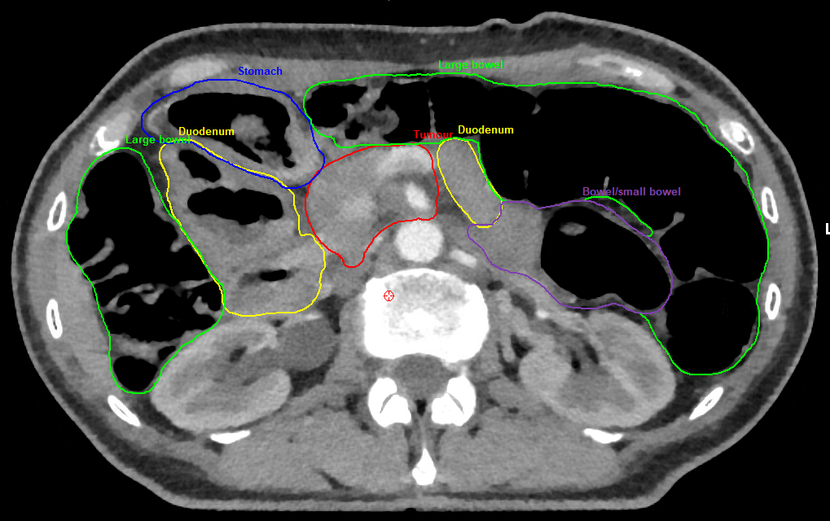
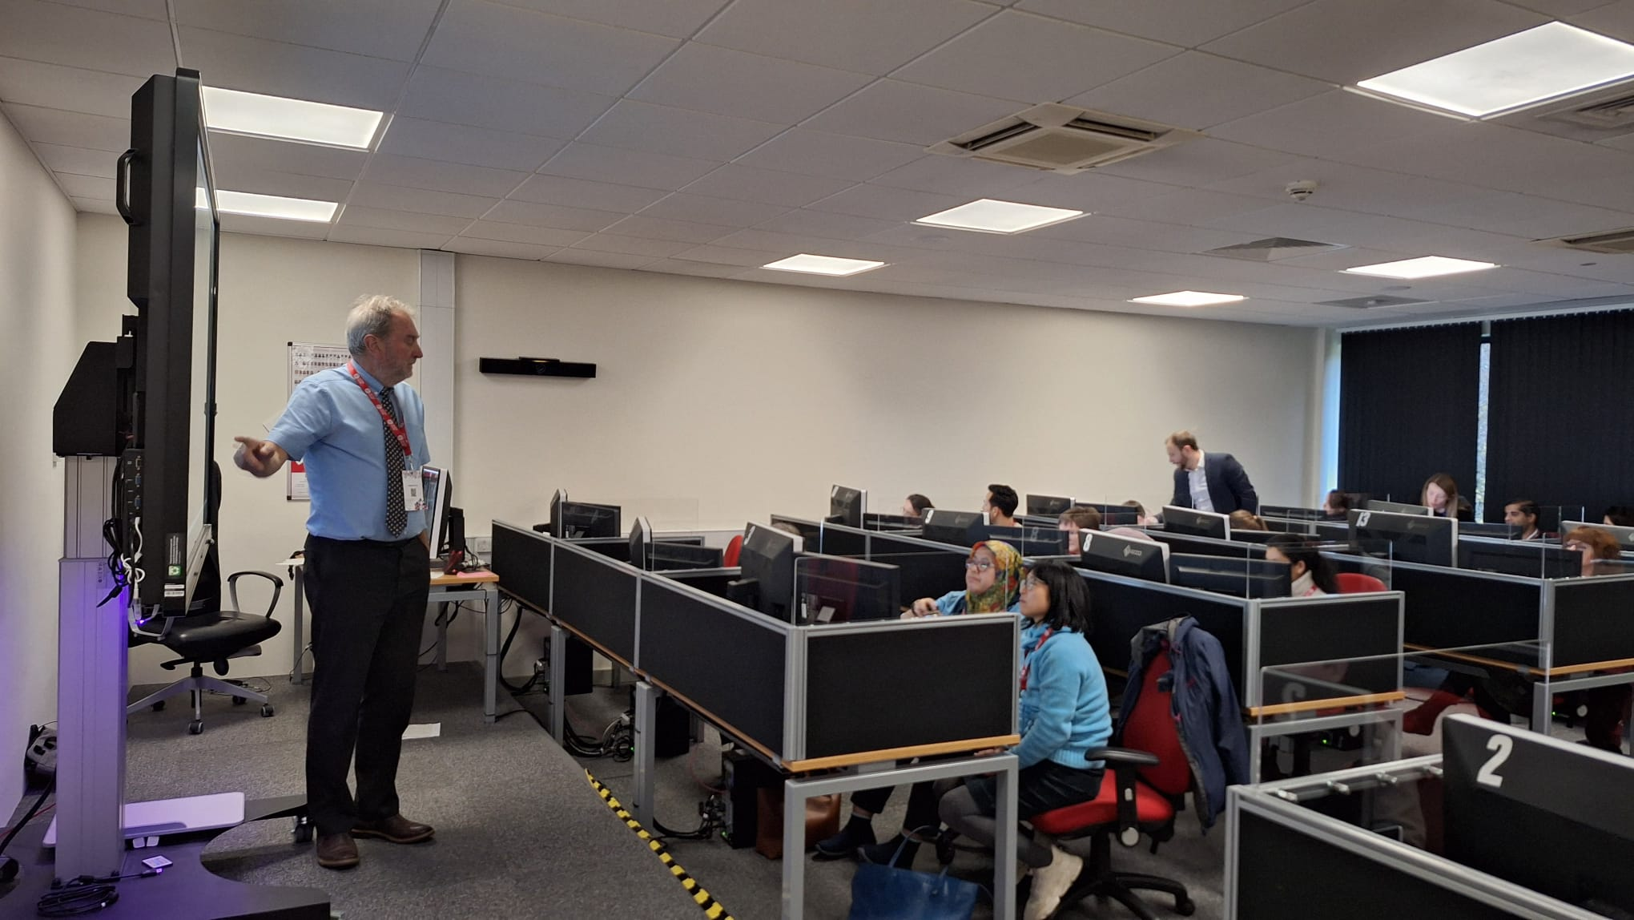
Bridging the Imaging Knowledge Gap: A Novel Workstation-based Radiology Education Programme for Oncology Residents
Ali Hussnain¹, Nicholas Gomez¹, Ashley Poon-King² , Clair Brunner¹, Ceri Powell², Philip Wardle³, Liam McKnight¹, Owen Nicholas¹
1. Swansea Bay University Health Board, Swansea, 2. Velindre University NHS Trust, Cardiff 3. National Imaging Academy of Wales (NIAW)
Background
WHY WAS THIS PROGRAMME NEEDED?
Programme Design
Imaging underpins modern oncology practice, particularly in radiotherapy where accurate interpretation of normal anatomy, tumour extent, and patterns of disease spread is essential. Despite this, radiology education tailored to oncologists is limited.
To address this gap, a collaborative teaching programme with the National Imaging Academy Wales (NIAW) was established in 2025, providing dedicated imaging education for oncology residents and radiotherapy professionals.
Since 2023, Consultant Radiologist-led sessions, supported by a Consultant Clinical Oncologist, are delivered every six months on a three-year rolling programme aligned with the Royal College of Radiologists Clinical Oncology curriculum.
Participants use individual workstations to work through clinical cases, developing skills in anatomical interpretation, malignant pathology, and practical use of radiology systems (PACS) relevant to routine oncology practice.
Learners identified a clear training gap
❝ We don't get formal radiology teaching in oncology. ❞
❝ This is a gap in our current training. ❞
Correct imaging interpretation for target volume and organ-at-risk definition in radiotherapy planning – RCR Clinical Oncology curriculum
Key Features
Education Model
Consultant Radiologist-led teaching
Oncology specialist input
Individual PACS workstation access
Interactive small-group support
Six-monthly delivery
Three-year rolling curriculum
Curriculum alignment with RCR Clinical Oncology training
National Imaging Academy Wales (NIAW)
Consultant Radiologist-Led Teaching​ with​ Consultant Clinical Oncologist Input​
Individual PACS Workstations and Real-World cases
Interactive Case-Based Learning (normal anatomy & malignant pathology) with Expert Faculty Support
Improved anatomical knowledge and confidence in imaging interpretation
What was valued most
Study Day | Area covered | Attendance
June 2023 | Pilot study day | 14
Dec 2024 | Introduction and oncological emergencies | 23
Jul2025 | Lung & breast | 22
Dec 2025 | GI tract | 16
July 2026 | Urology and Gynae | 19
Dec 2026 | H&N and Lymphoma | TBC
July 2027 | Neuro/ Sarcoma | TBC
Anatomy & Imaging Interpretation
“Helpful to go through all the cases and relevant anatomy.”
Participants consistently highlighted anatomical teaching and image interpretation skills.
Radiotherapy Planning & Contouring
“Would certainly aid my development and help with contouring.”
Learners recognised direct applicability to treatment planning and delineation.
Radiology-Oncology Collaboration
“Helpful having the perspective of both oncology and radiology.”
The multidisciplinary faculty model was repeatedly praised.
General feedback
Discussion
Conclusion
“I feel much more comfortable looking at scans now.”
“I feel more confident in interpreting imaging compared to before.”
“Most helpful radiology teaching I've had.”
“Please continue such sessions.”
“Highly informative day, very pleased it will become a regular addition as it is a gap in our current training!”
>90% attendees would recommend this course to others
This programme demonstrates that a consultant-led, workstation-based radiology teaching programme can provide sustainable, highly relevant imaging education for multidisciplinary audience.
Feedback demonstrates:
Strong learner engagement
Perceived improvements in imaging interpretation and use of PACS
Improved confidence in radiotherapy planning and contouring
The programme successfully leverages existing radiology expertise and infrastructure to address a recognised educational need.
To our knowledge, this is the only structured, workstation-based radiology training programme for oncologists in the UK.
A structured workstation-based radiology programme successfully addressed a recognised gap in oncology training.
Evaluation across five teaching events demonstrated sustained learner engagement and positive educational outcomes.
Participants reported improved confidence in image interpretation, anatomy recognition, PACS utilisation and radiotherapy planning.
The programme offers a scalable and transferable model that could be adopted more widely within Clinical Oncology training

